Slide 1
Authentication for Web APIs using JSON Web Tokens
Frank Walsh, 2022

Slide 2

Agenda
JSON Web Tokens (JWT)
Authentication
Salting/hashing with Bcrypt
Authentication Middleware
Use Case – Login/Register for React App using JWT/Passport

Slide 3
Authentication for MovieDB API
Restrict access to authenticated users.
Provide API to login/register.
Users should only have to log in once:
Ideally identified and authenticated in subsequent requests.
Username and Password authentication.
No clear case passwords like last week!!!
Hash/Salt all passwords in MongDB

Slide 4
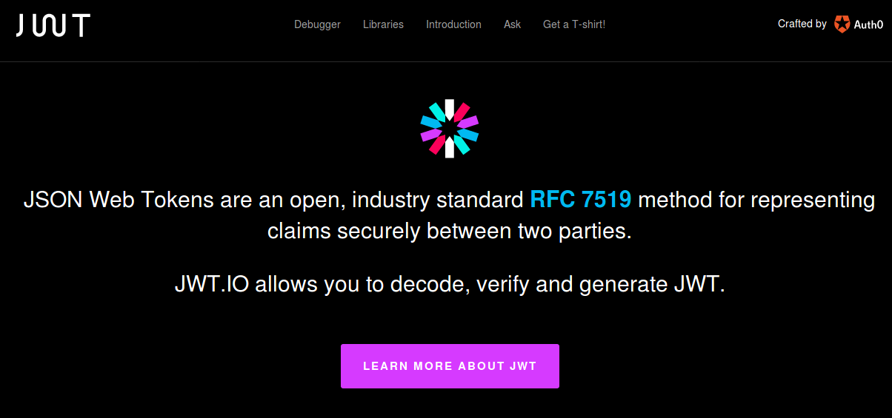
Authentication options
Many solutions for Auth
Cookies, basic-auth, JWT, Oauth.
Web-based Identity Federation/3rd Party (Firebase)
JSON Web Tokens (JWT)
Tokens means no need to keep sessions or cookies
In keeping with REST stateless principle – token sent on each request
Token stored on client, usually in local storage of client.
Notes:
OAuth (Open Authorization) is an open standard for token-based authentication and authorization on the Internet.
Cookie authentication uses HTTP cookies toauthenticate client requests and maintain session information.
In basic HTTP authentication, a request contains a header field of the form Authorization: Basic <credentials>, where credentials is the base64 encoding of id and password joined by a colon.

Slide 5
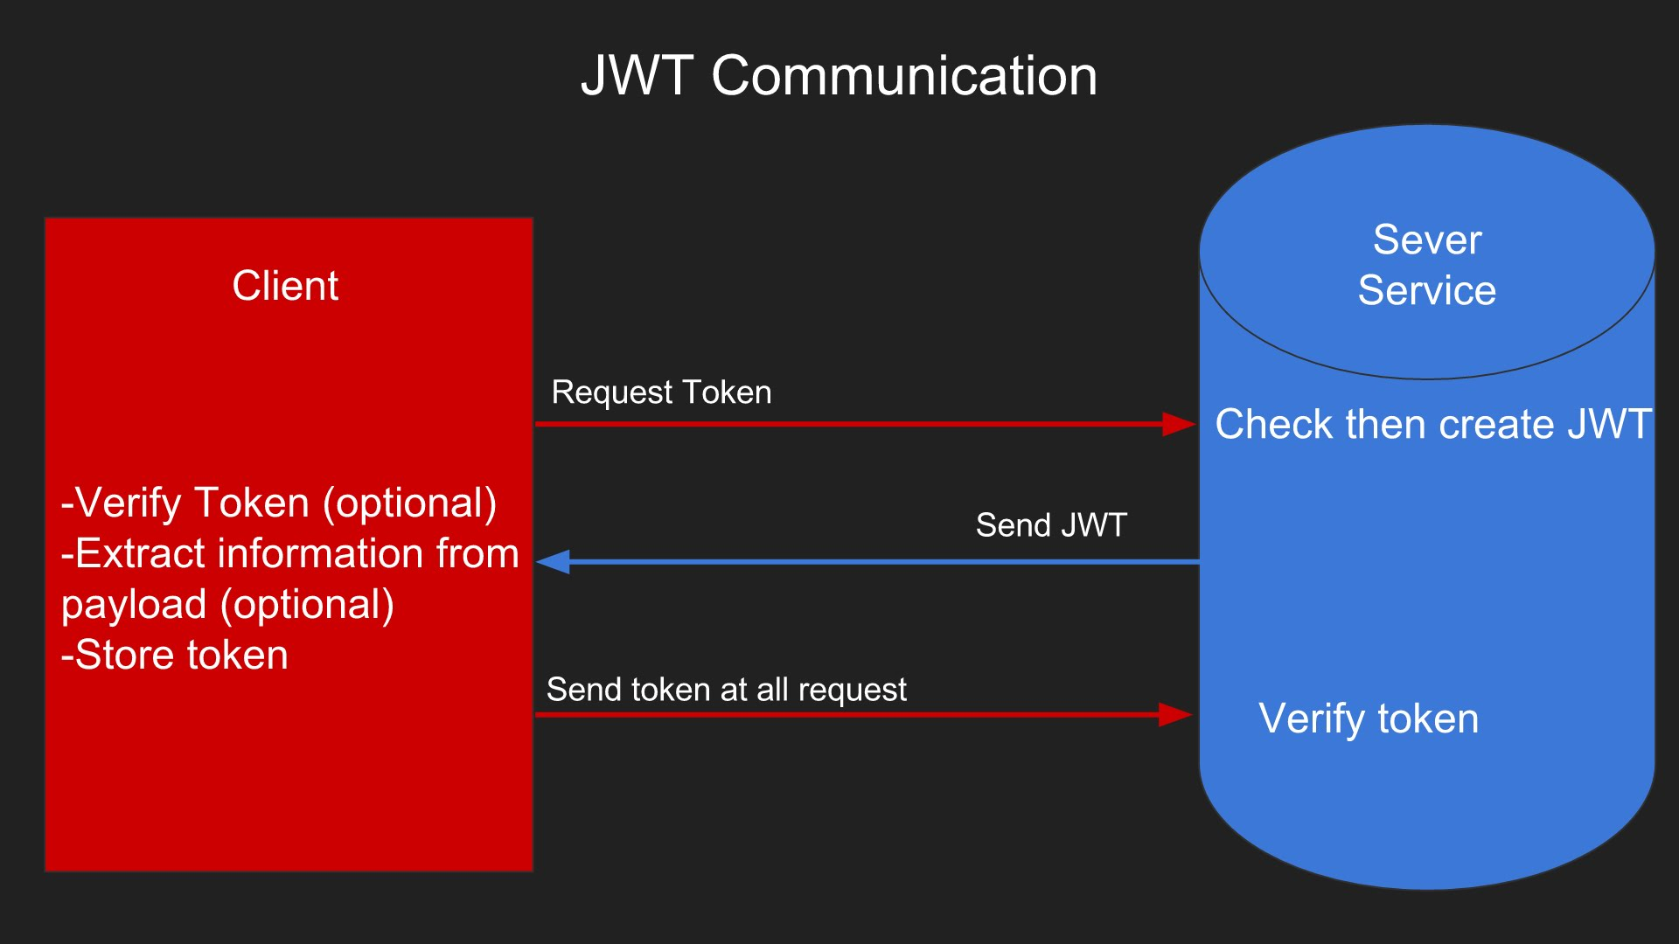
JSON Web Tokens
Notes:
defines a compact and self-contained way for securely transmitting information between parties as a JSON object.
information can be verified and trusted because it is digitally signed.
Once the user is logged in, each subsequent request will include the JWT, allowing the user to access routes, services, and resources that are permitted with that token. Single Sign On is a feature that widely uses JWT nowadays, because of its small overhead and its ability to be easily used across different domains.

Slide 6
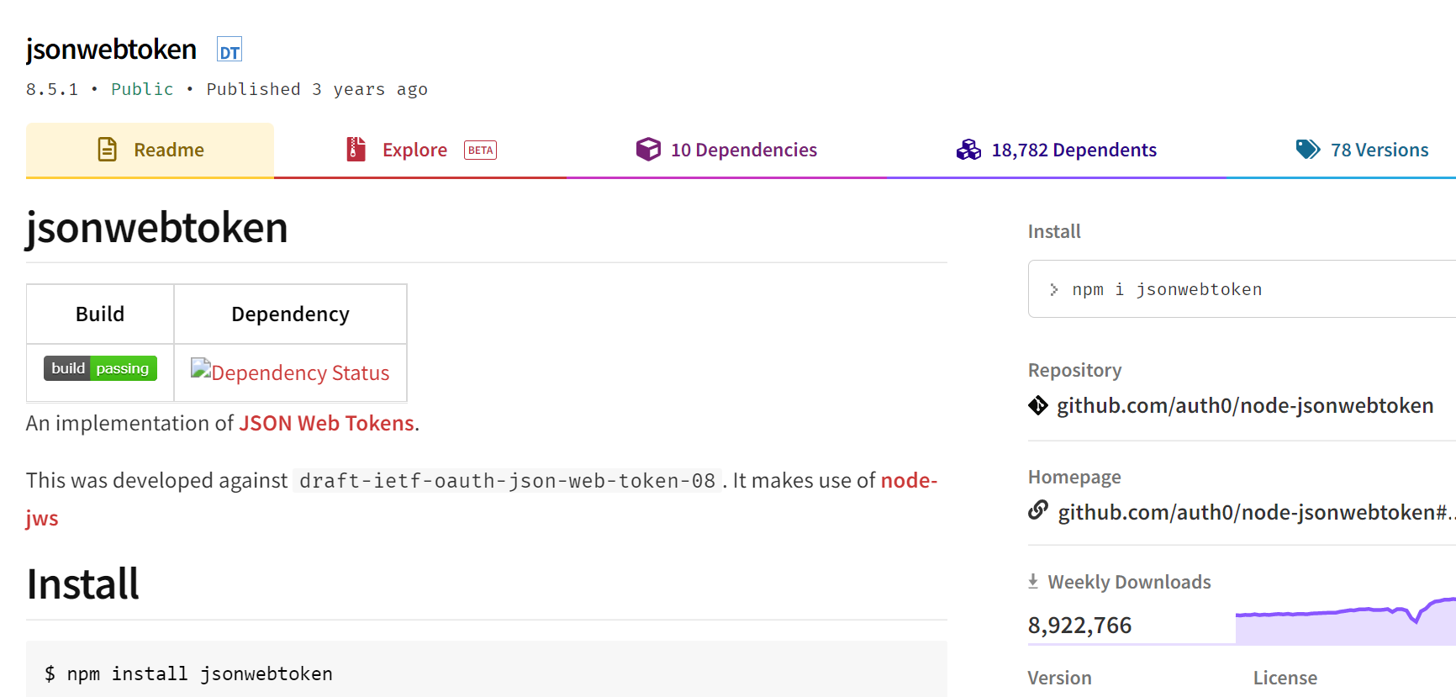
JWT in Node/Express
Use jsonwebtoken NPM module.
Implementation of JSON Web Tokens RFC

Slide 7
Authentication/Security Scenarios
1. Register Account:
Account signs up to access an API (email & password)
Create a new account in database with encrypted password
2. Generate security token:
Client sends email and password to authenticate
Create a JWT Token and send JWT back to client
Client stores JWT locally
JWT used on every subsequent request to protected resource
3. Protect routes (e.g. /api/movies)
Valid JWT token included in each request
Token used to identify/validate account before passing request to core service

Slide 8

Web Authentication – credentials
Credentials should be stored securely in a centralised location
Should only be readable by suitably privileged accounts
Credentials should not find their way into hidden fields, headers, cookies
Should not be “hard coded”
Passwords should be “salted” and “hashed”
Salting involves appending random bits to each password
Salted password is then hashed (i.e. one-way encrypted) for storage
Objective is to store something derived from the password that allows an entered candidate password to be checked …
… but such that the password cannot be retrieved (by anybody, even an administrator)

Slide 9
Password Salting & Hashing
Password Creation
Password Verification
Plain Text Password
Salt
Plain Text Password
Hashing function
Hashing function
Hash
Do They Match?
Stored Credentials
Stored Credentials
Salt
Hash
Salt
Hash

Slide 10

Why Salt?
Frustrates dictionary attacks.
Prevents duplicate passwords appearing as duplicates in password db (using different Salts)
Protects users where same password is reused on different systems/sites.
This Photo by Unknown Author is licensed under CC BY-SA

Slide 11
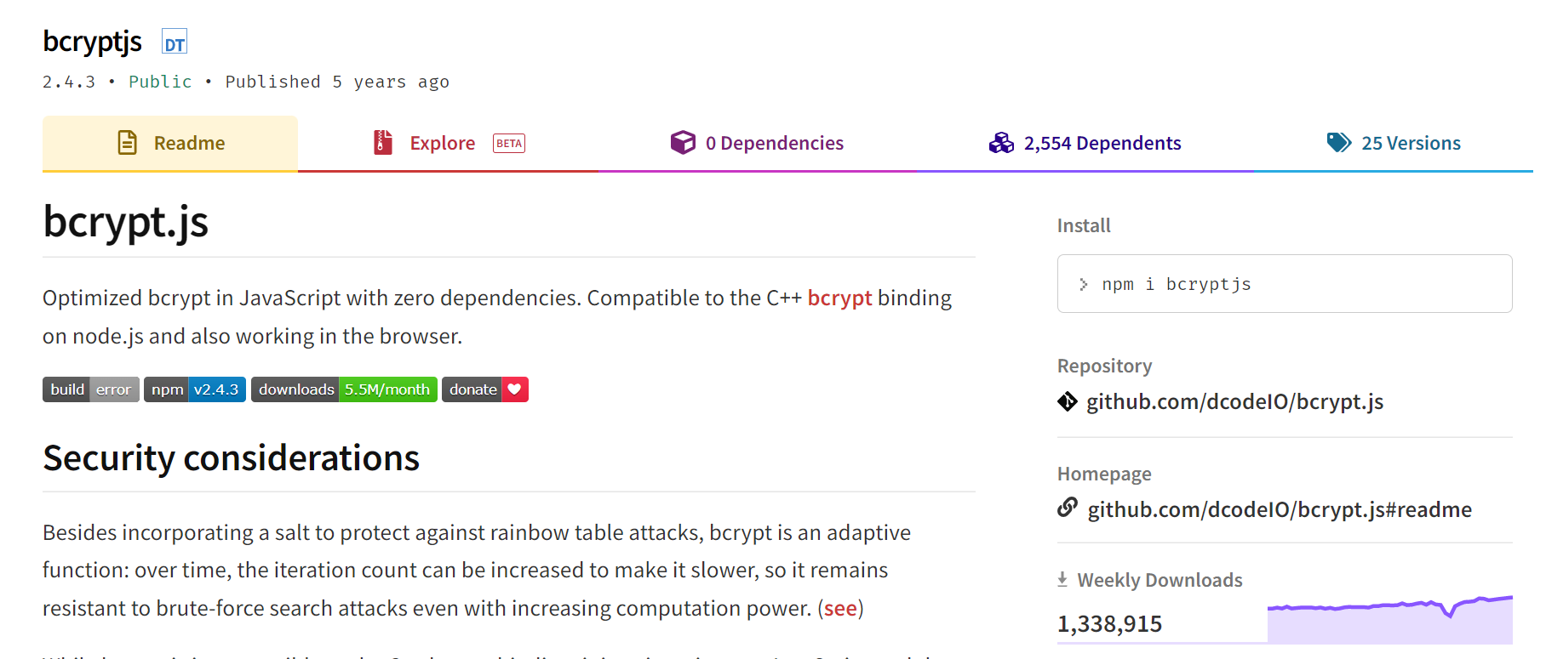
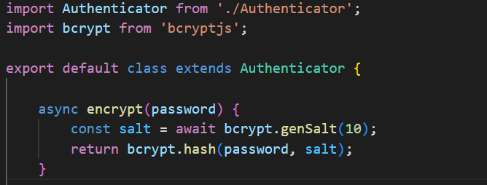
Salting and Encrypting in Node.js/Express
Several NPM packages available.
Also in other languages (Java,python)

Slide 12
Encrypting – Middleware Controller

Slide 13
User API: User Routes
Update Account API to support following Endpoints
Use query string of URL to specify action:
register/authenticate
Route | GET | POST | PUT | DELETE
/api/accounts/security/token | N/A | Authenticate Account using Email/Password | N/A | N/A
/api/accounts/ | Admin only | Register Account | N/A | N/A

Slide 14
Encryption and Token dependencies
Using Clean Architecture

Slide 15
Clean Architecture for Security/Encryption
We’ll continue to follow Clean Architecture approach as before…
Code Dependencies can only move from the outer layers inward.
To be flexible with project dependencies, use dependency injection to inject external infrastructure/frameworks into your layers
Use base Classes to define “contracts”, the functional signatures of the desired service without implementation details.
Services we need to provide here are:
Encryption:
Password encryption/Password compare
Security Token Management
Generate/decode Security Token.

Slide 16
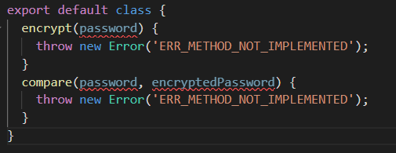


Encryption: Hash/Salt Passwords & compare
import Authenticator from './Authenticator';
import bcrypt from 'bcryptjs';
export default class extends Authenticator {
async encrypt(password) {
const salt = await bcrypt.genSalt(10);
return bcrypt.hash(password, salt);
}
async compare(password, encryptedPassword) {
try {
// Compare password
const result = await bcrypt.compare(password, encryptedPassword);
return result;
} catch (error) {
return false;
}
}
}
Define Encryption “Contract”
Use bcryptjs package to hash and salt passwords before saving to repository
For authentication, use bcrypt package compare clear case password(e.g. test123@&) to already encrypted password in the Repository.
Notes:
With "salt round" they actually mean the cost factor. The cost factor controls how much time is needed to calculate a single BCrypt hash. The higher the cost factor, the more hashing rounds are done. Increasing the cost factor by 1 doubles the necessary time. The more time is necessary, the more difficult is brute-forcing.
Store the cost, salt, and cipher text. Because these three elements have a known length, it's easy to concatenate them and store them in a single field, yet be able to split them apart later.

Slide 17
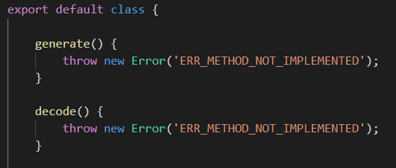

Security Tokens: Using JWT
import jwt from 'jsonwebtoken';
import Token from './Token';
export default class extends Token {
generate(payload) {
return jwt.sign(payload, process.env.JWT_SECRET_KEY );
}
decode(accessToken) {
return jwt.verify(accessToken, process.env.JWT_SECRET_KEY);
}
}
Define Token Service “contract” as class
Use jsonwebtoken package to provide concrete imeplementation
Notes:
With "salt round" they actually mean the cost factor. The cost factor controls how much time is needed to calculate a single BCrypt hash. The higher the cost factor, the more hashing rounds are done. Increasing the cost factor by 1 doubles the necessary time. The more time is necessary, the more difficult is brute-forcing.
Store the cost, salt, and cipher text. Because these three elements have a known length, it's easy to concatenate them and store them in a single field, yet be able to split them apart later.

Slide 18
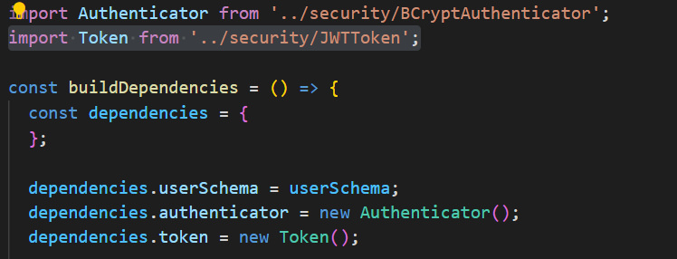
Add to Dependencies
We can add both authentication and token services as project dependency using dependency injection.
/src/config/dependencies.js

Slide 19
1. registerAccount Service
Update registerAccount to use authenticator dependency. Encrypt Password before persisting…
1. Get Authenticator from dependencies using destructuring
registerAccount: async (firstName, lastName, email, password, { accountsRepository, authenticator }) => {
password = await authenticator.encrypt(password);
const account = new Account(undefined, firstName, lastName, email, password);
return accountsRepository.persist(account);
}
2. Encrypt password before persisting

Slide 20
Authenticate Service
Authenticate Service uses authenticator dependency.
Uses email to extract account from Repository
Uses authenticor to compare passwords
Client needs to keep token for subsequent messaging
store JWT in local storage.
1. Get Authenticator from dependencies using destructuring
authenticate: async (email, password, { accountsRepository, authenticator, tokenManager }) => {
const account = await accountsRepository.getByEmail(email);
const result = await authenticator.compare(password, account.password);
if (!result) {
throw new Error('Bad credentials');
}
const token = tokenManager.generate({ email: account.email });
return token;
}
2. Get account from Repo using email and compare password to saved password
3. tokenManager used to generate JWT token, encoding the account email.

Slide 21
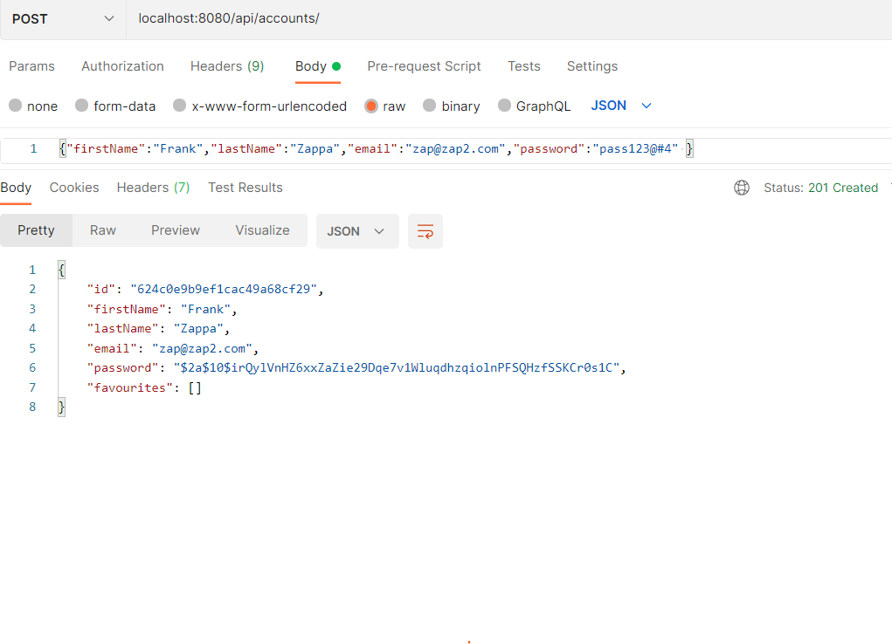
Registering Account
Hashed/Salted value for password “pass123@#4"

Slide 22
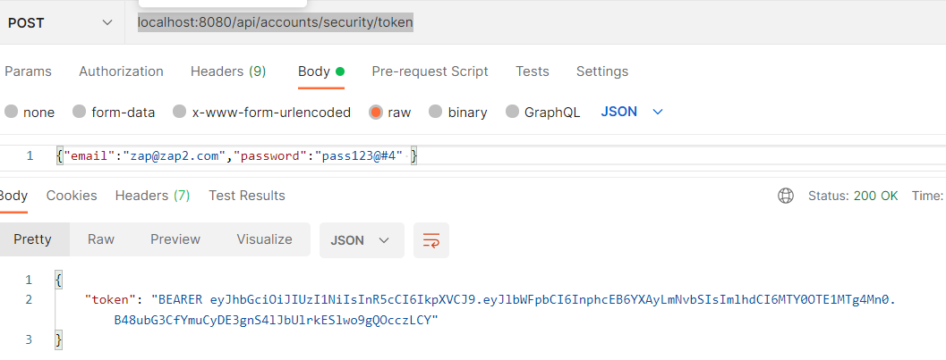
Requesting Security Token
JWT Token. This should be stored locally

Slide 23
Protecting API Routes using JWT

Slide 24

Protecting API Routes: Create Service and Controller
/authenticate/index.js
const verify = async (request, response, next) => {
try {
// Input const authHeader = request.headers.authorization;
// Treatment
if (!authHeader || !authHeader.startsWith('Bearer ')) {
response.status(403).json({message:"Forbidden"});
}
const accessToken = authHeader.split(" ")[1];
const user = await accountService.verifyToken(accessToken, dependencies);
//output
next();
}catch(err){
//Token Verification Failed
next(new Error(`Token Verification Failed ${err.message}`));
}
};
Create a new service and controller that checks for and validates the JWT token
Verify controller: Extracts token from request header and sends to service
VerifyToken service: Accepts token, decodes email from token, and checks if belongs to an account
verifyToken: async (token,{accountsRepository, tokenManager}) => {
const decoded = await tokenManager.decode(token);
const user = await accountsRepository.getByEmail(decoded.email);
if (!user) {
throw new Error('Bad token');
}
return user.email;
}

Slide 25
Protecting API Routes: Add to route
/authenticate/index.js
import express from 'express';
import MoviesController from '../controllers';
import AccountsController from '../../accounts/controllers';
const createMoviesRouter = (dependencies) => {
const router = express.Router();
// load controllers with dependencies
const moviesController = MoviesController(dependencies);
const accountsController = AccountsController(dependencies);
router.route('/:id')
.get(moviesController.getMovie);
router.route('/')
.get(accountsController.verifyToken,moviesController.find);
router.route('/:id/reviews')
.get(moviesController.getMovieReviews);
return router;
};
export default createMoviesRouter;
Import Controller into router
Add to route…

Slide 26
React Apps and JWT

Slide 27
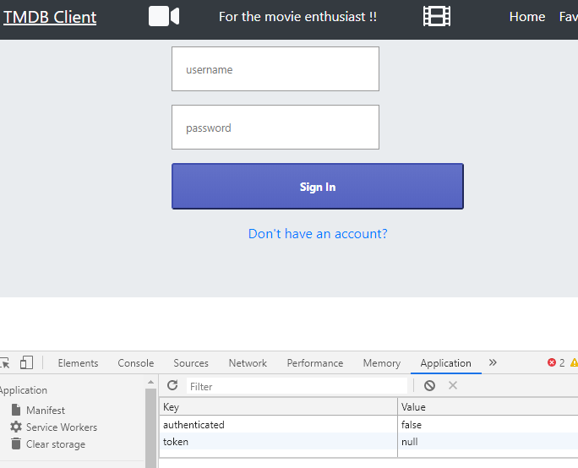
MovieDB App
We want to:
Replace with calls to MovieDB API
Provide login/signin capabilities.
Only allow signed in users to see Movies and add stuff

Slide 28

Possible Architecture
Create-React-app uses Webpack development server.
MovieDB API is an Express.js app.
Configure Webpack server to "proxy" any unknown requests to Express app
Just need "proxy":"http://localhost:8080" entry in package.json.
Removes Cross-Origin-Resource-Sharing (CORS) issues with the browser

Slide 29
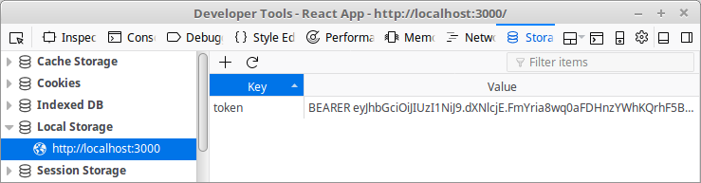
JavaWebToken Storage
Most browsers/devices have local storage .Can access using localStorage object.
localStorage.setItem('token', token);
const token = localStorage.getItem('token');

Slide 30
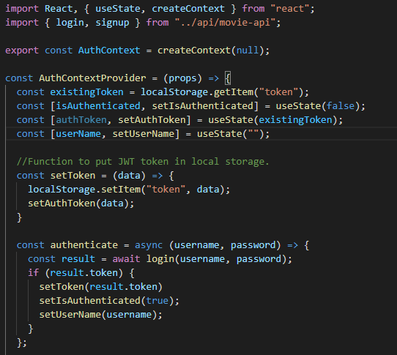
Contexts
Create an Authentication Context in MovieDB React App.
As with Movie and Genre contexts, use it to pass data through the component tree
Share authentication details between components

Slide 31
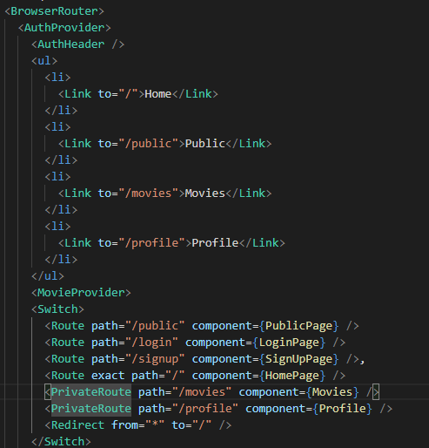
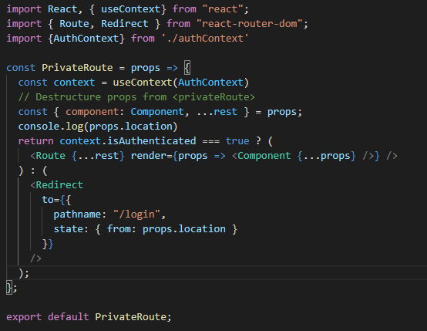
Use Context Provider in React App
Import context and use it to check authentication status

Slide 32
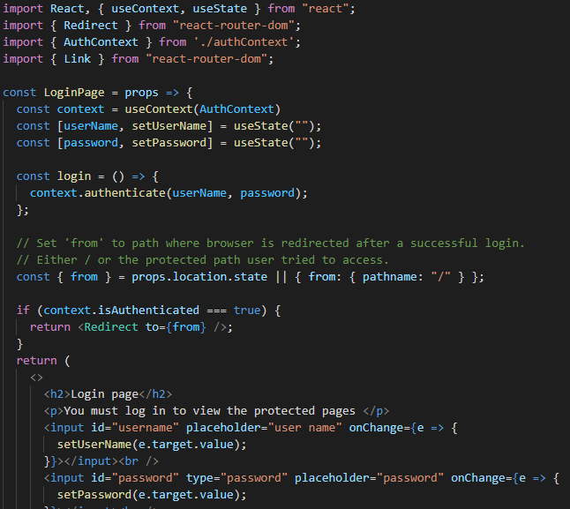
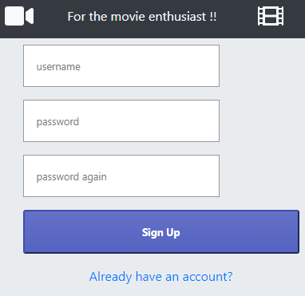

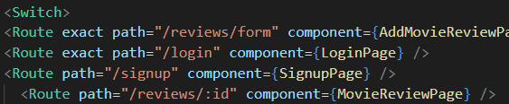
Login/Register Component

Slide 33
Summary
Create Authentication functionality using passwords
salt/hash passwords
compare passwords
Implement user API to authenticate/signup users
Sign JWT tokens
Use authentication controller to secure server-side routes
Add to middleware stack.

Slide 34

Additional: Passport
Passport is authentication middleware
Flexible and modular.
Easy to retrospectively drop into an Express app.
Lots of "strategies" for authentication
Username/Password
Facebook
Twitter

Slide 35
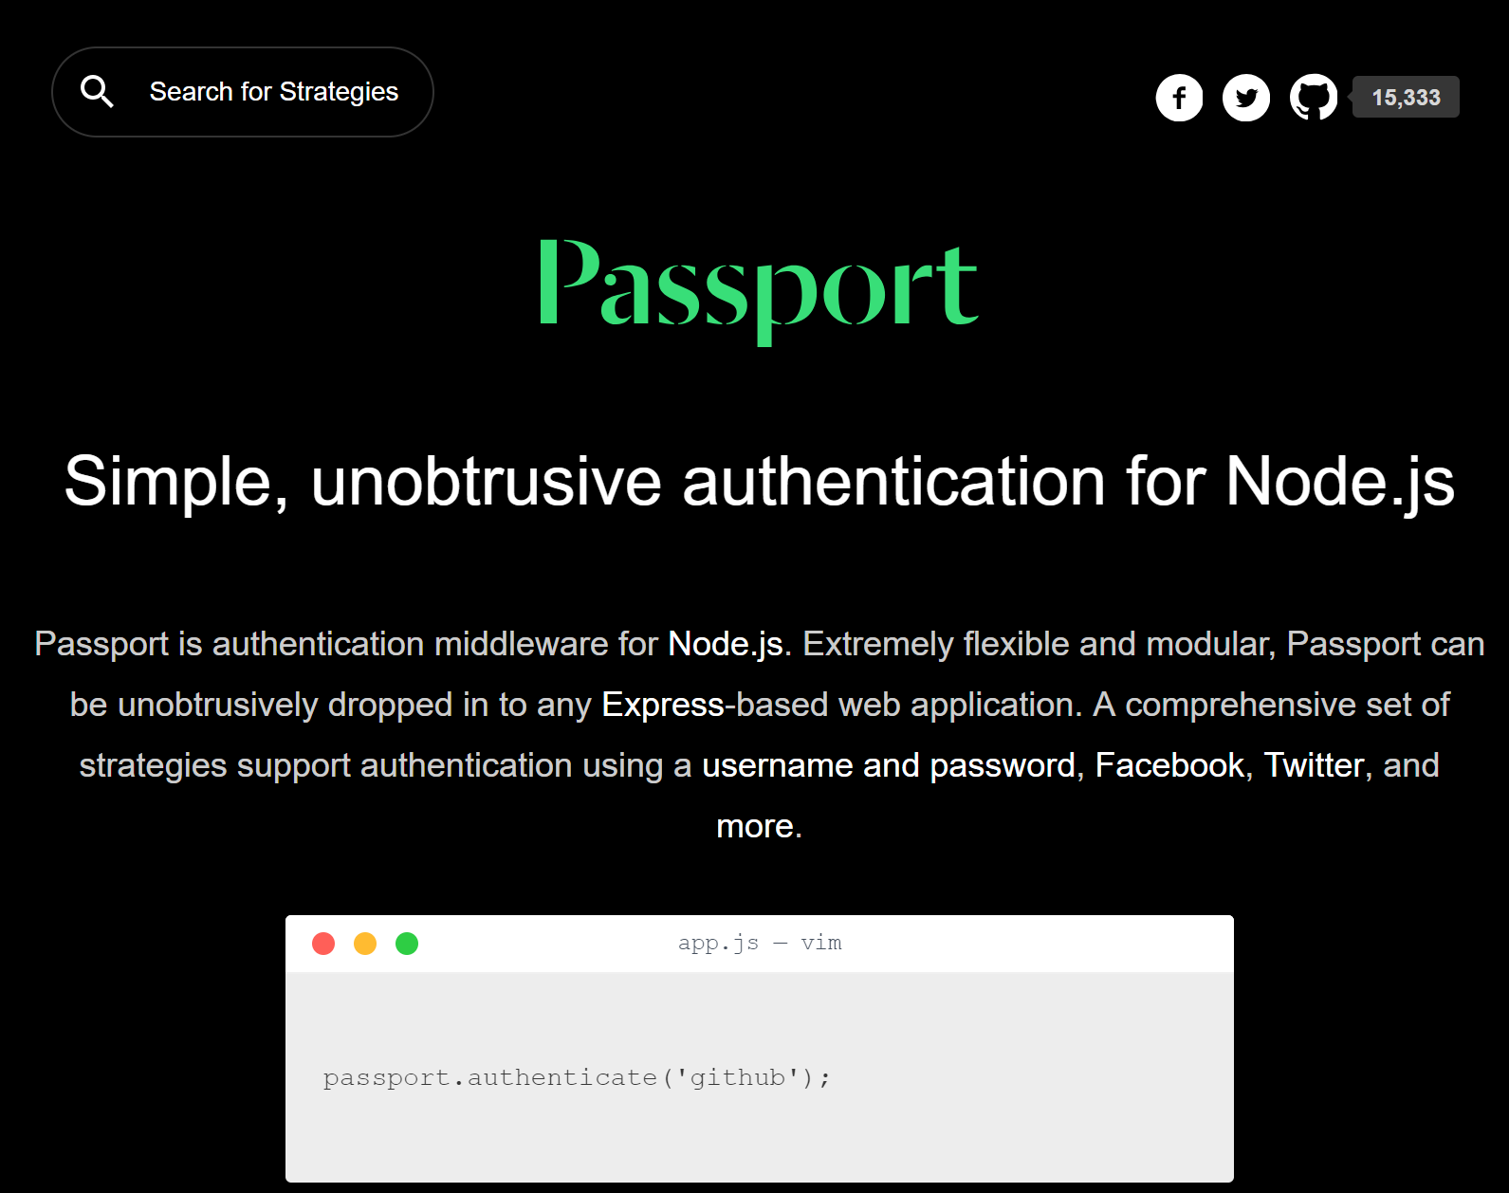

Slide 36
Passport Overview
Passport offers different authentication mechanisms as Strategies
You install just the modules you require for a particular strategy
Authenticate by calling passport.authenticate()
specify which strategy to use.
The authenticate() function signature is a standard Express middleware function…
Just drop it in..

